Slide 1
Week 4: Image Enhancement Fatos Yarman Vural and Hazal Moğultay
Prepare image for further processing steps for specific applications

Slide 2
Image Enhancement: Accentuating some characteristics of image for a predefined goal
Blurring
Smoothing
Sharpening
Contrast Stretching
Edge-line-boundary detection

Slide 3
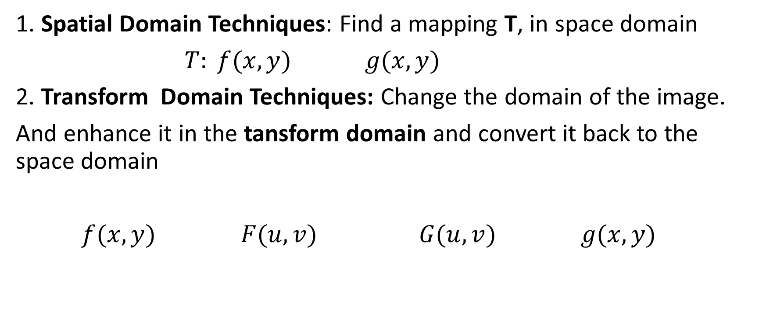
Image Enhancement Techniques
1. Spatial Domain Techniques: Find a mapping T, in space domain
$T: f(x,y) g(x,y)$
2. Transform Domain Techniques: Change the domain of the image.
And enhance it in the tansform domain and convert it back to the space domain
$f(x,y) F(u,v) G(u,v) g(x,y)$
F
T
F⁻¹

Slide 4
Spatial Domain Techniques
Intensity transform, point operations, which changes the color palette of an image, independent of the position of a pixel.
Spatial Filtering, which changes the brightness value of a pixel, depending on its position.

Slide 5
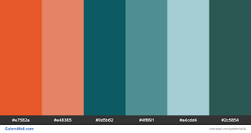
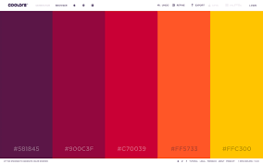
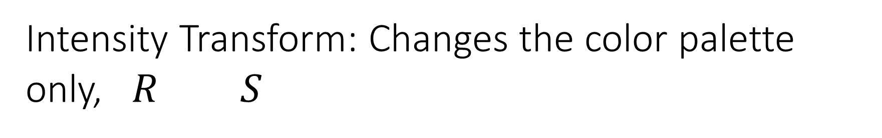


Intensity Transform: Changes the color palette only, $R S$
Gray Scale transform
Bit plane slicing
Histogram processing
$$R$$
$$S$$

Slide 6
1. Grayscale tansform, s=T(r)
Convert a given brightness value to a new value based on some predefined function, independent of its location.

Slide 7

1. Grayscale transform: Linear Transforms,
s
r original color, s transformed color
L-1
s=2r
s=r
$$s=T(r) = a.r$$
s=0.5r
L-1
r

Slide 8
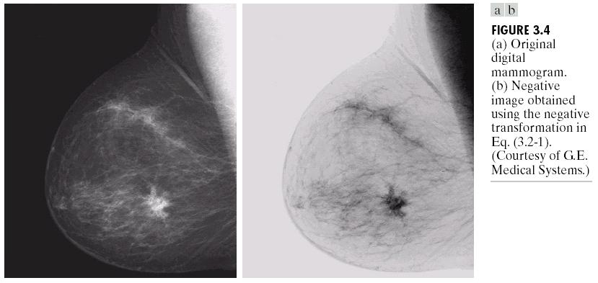
Gray Scale transform- Negation: s= T(r)

Slide 9
Gray Scale transform- Contrast stretching, Thresholding
Thresholding
Contrast stretching

Slide 10
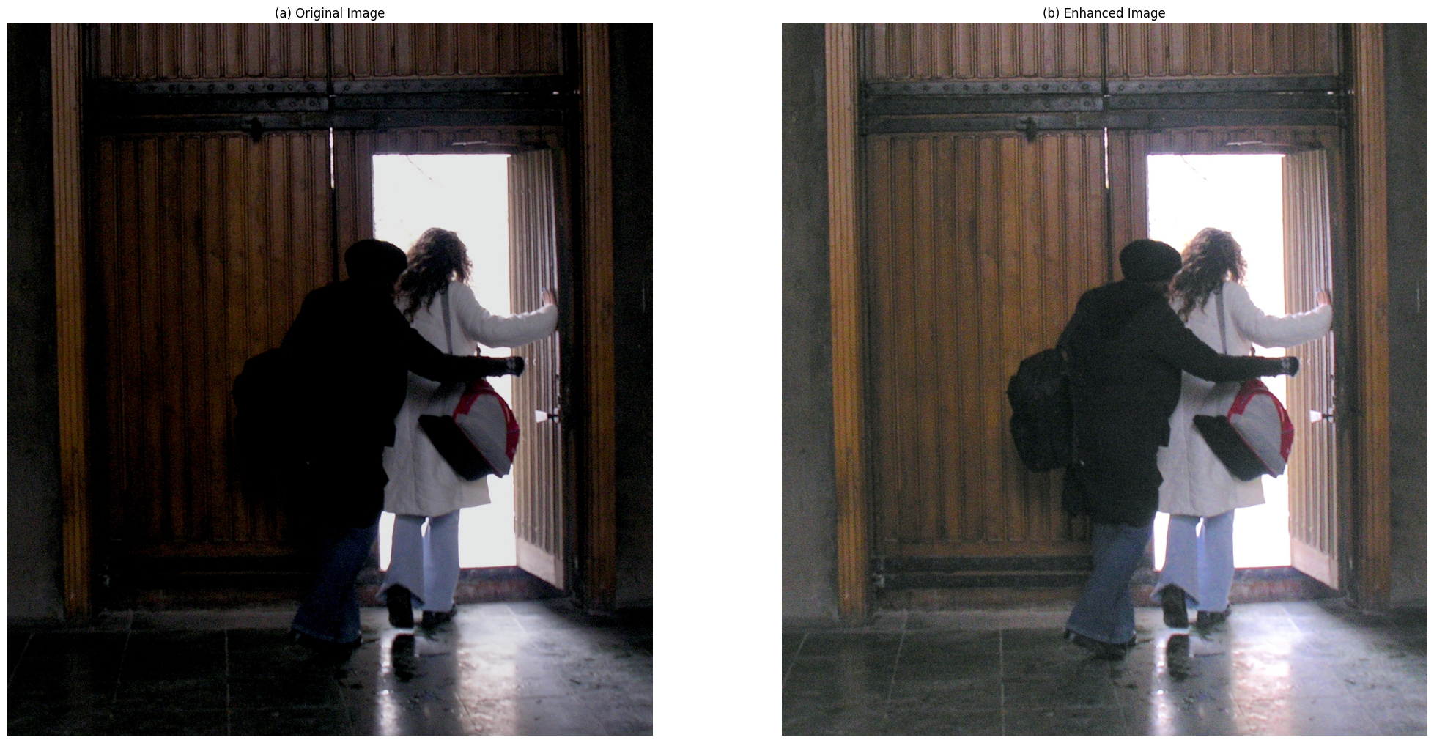
Q: What type of a transform do you suggest to enhance the contrast of the left image?

Slide 11
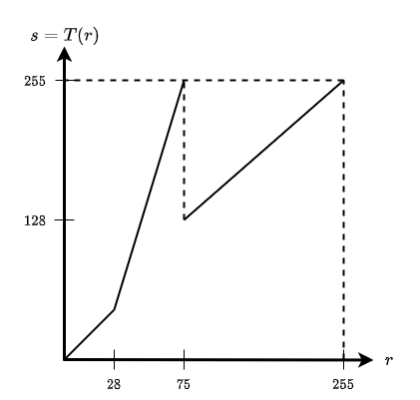

Slide 12
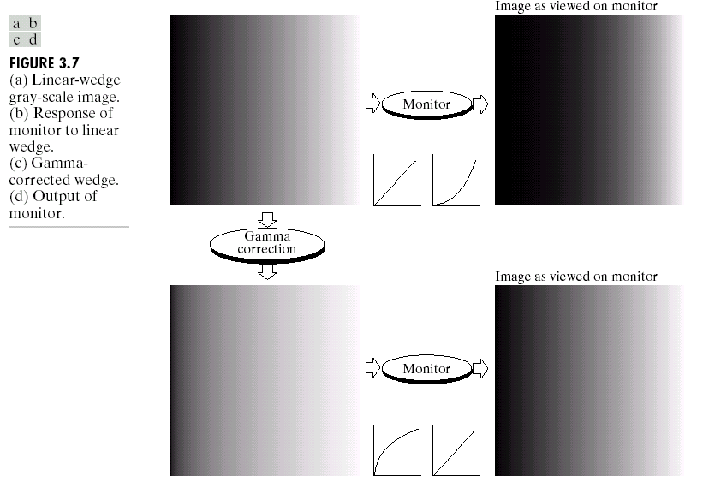
Gray Scale Transform- Gamma Correction

Slide 13
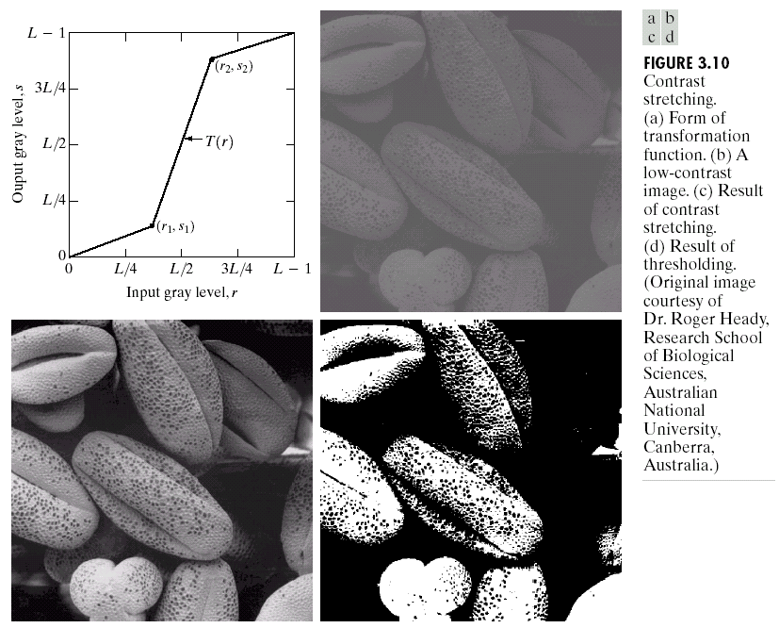
Gray scale transform- Contrast Stretching

Slide 14
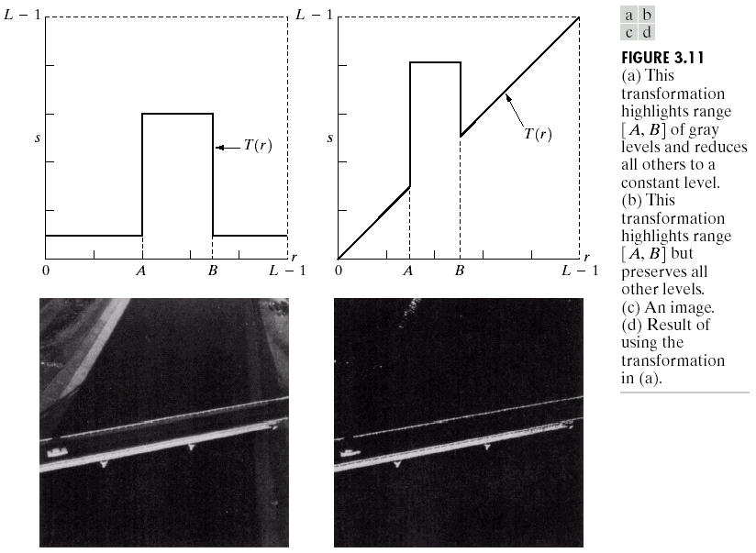
Gray scale transform- Highlight

Slide 15
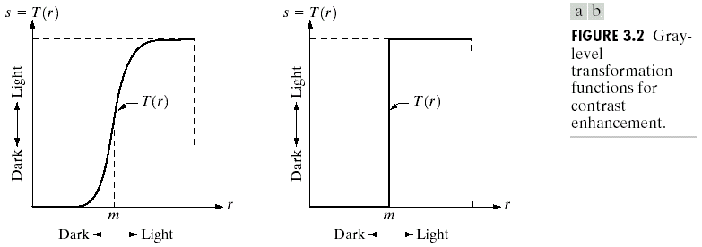
Gray Scale Transform: Binarization
Thresholding to Binarize

Slide 16
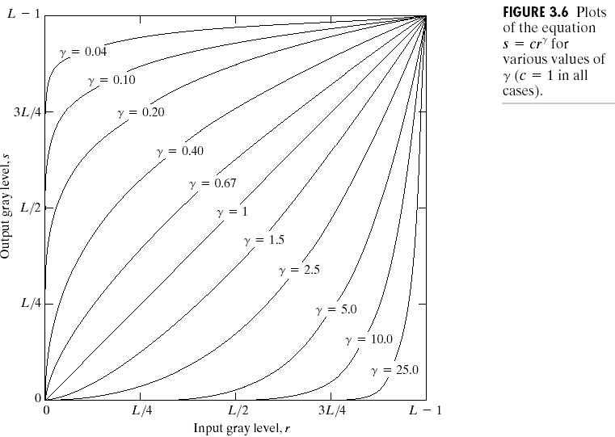
Gray scale tansform Power law transform: s =cr^{γ}

Slide 17
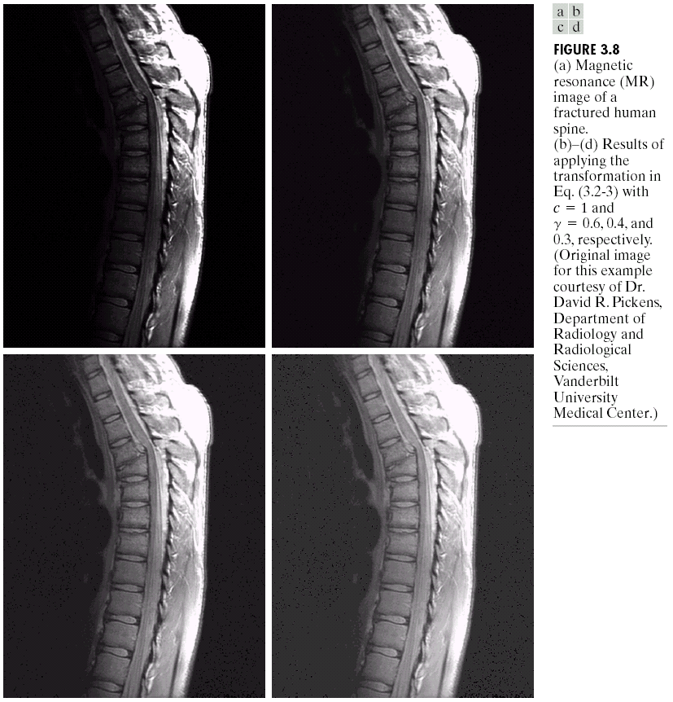
Power Low Transform Examples

Slide 18
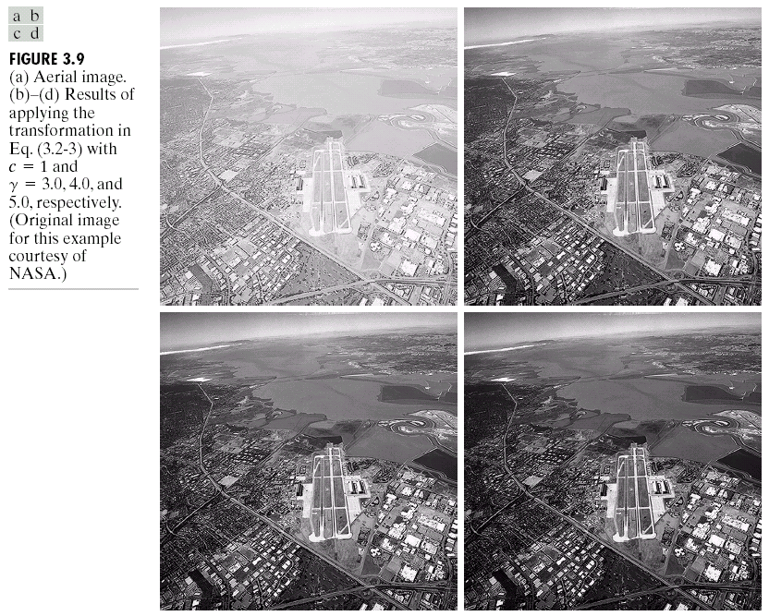
Power Low Transform Examples

Slide 19
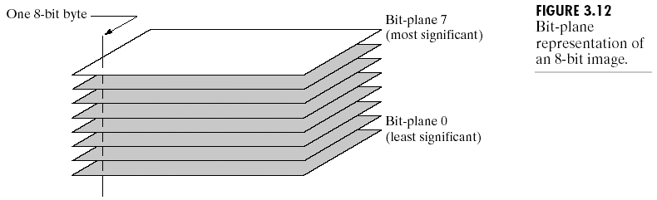
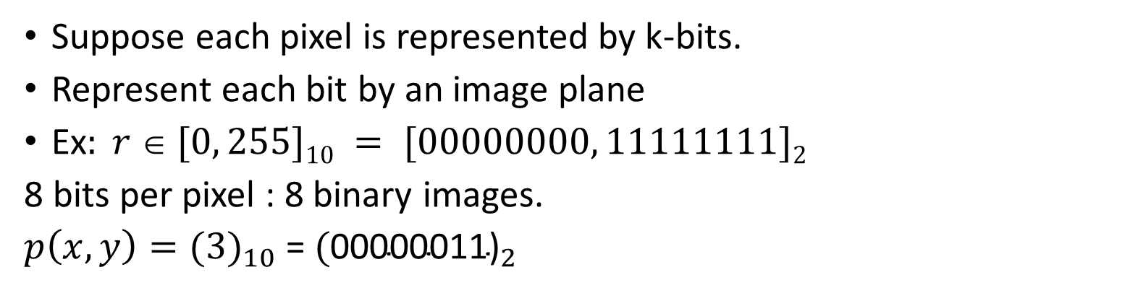
2. Bit plane slicing
Suppose each pixel is represented by k-bits.
Represent each bit by an image plane
Ex$: r  [0, 255]10 = [00000000, 11111111]2$
8 bits per pixel : 8 binary images.
$p\left(x,y\right)={(3)}_{10}$= ${\text{(}\text{00000011}\text{)}}_{2}$

Slide 20
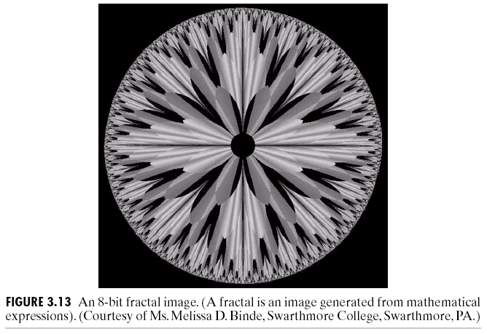
Bit-plane slicing

Slide 21
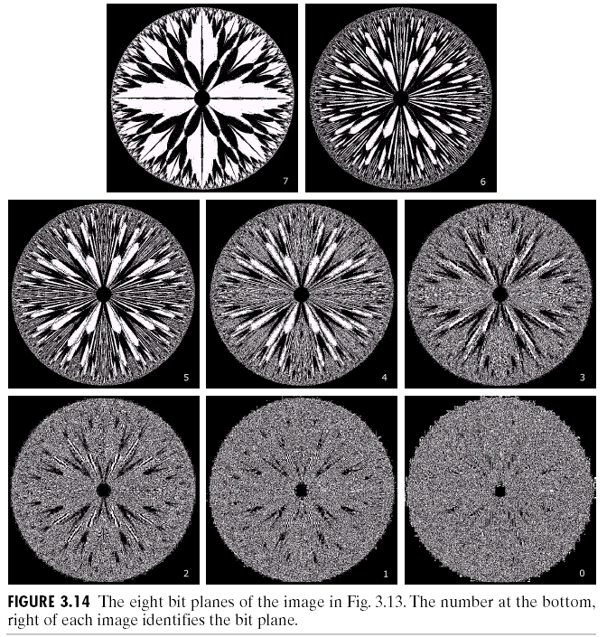
Bit Plane Slicing

Slide 22
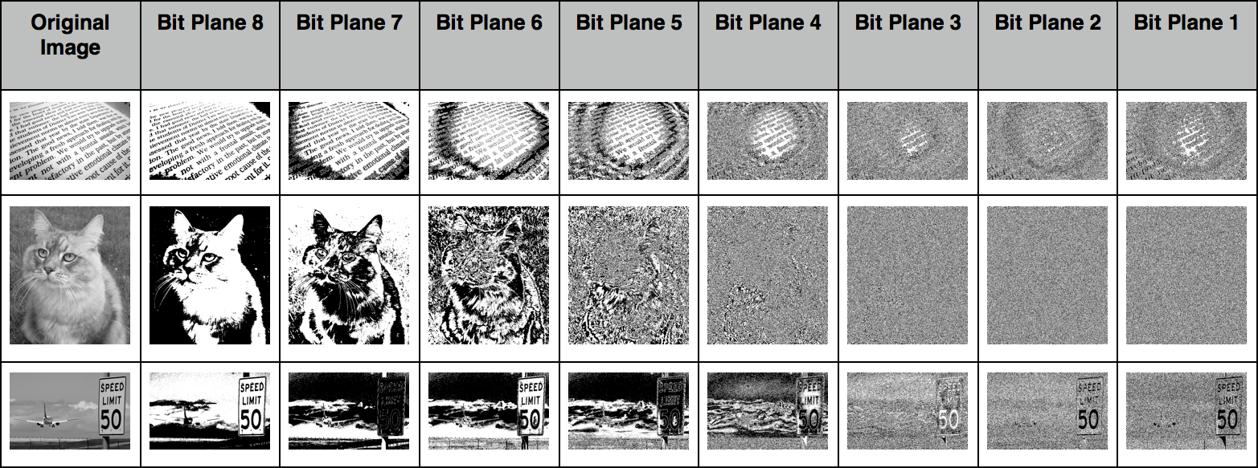

Slide 23
3. Histogram Processing
Histogram Equalization
Histogram Specification (Matching)
Using Histogram Statistics for Image Enhancement

Slide 24
Definition: Histogram and Normalized Histogram

Slide 25
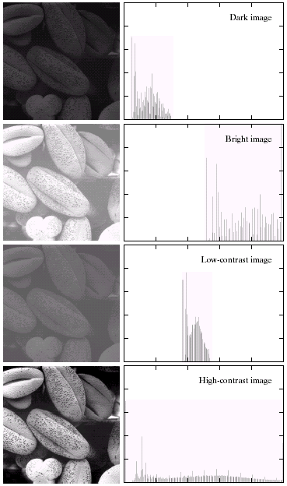

Histograms of Various Images

Slide 26
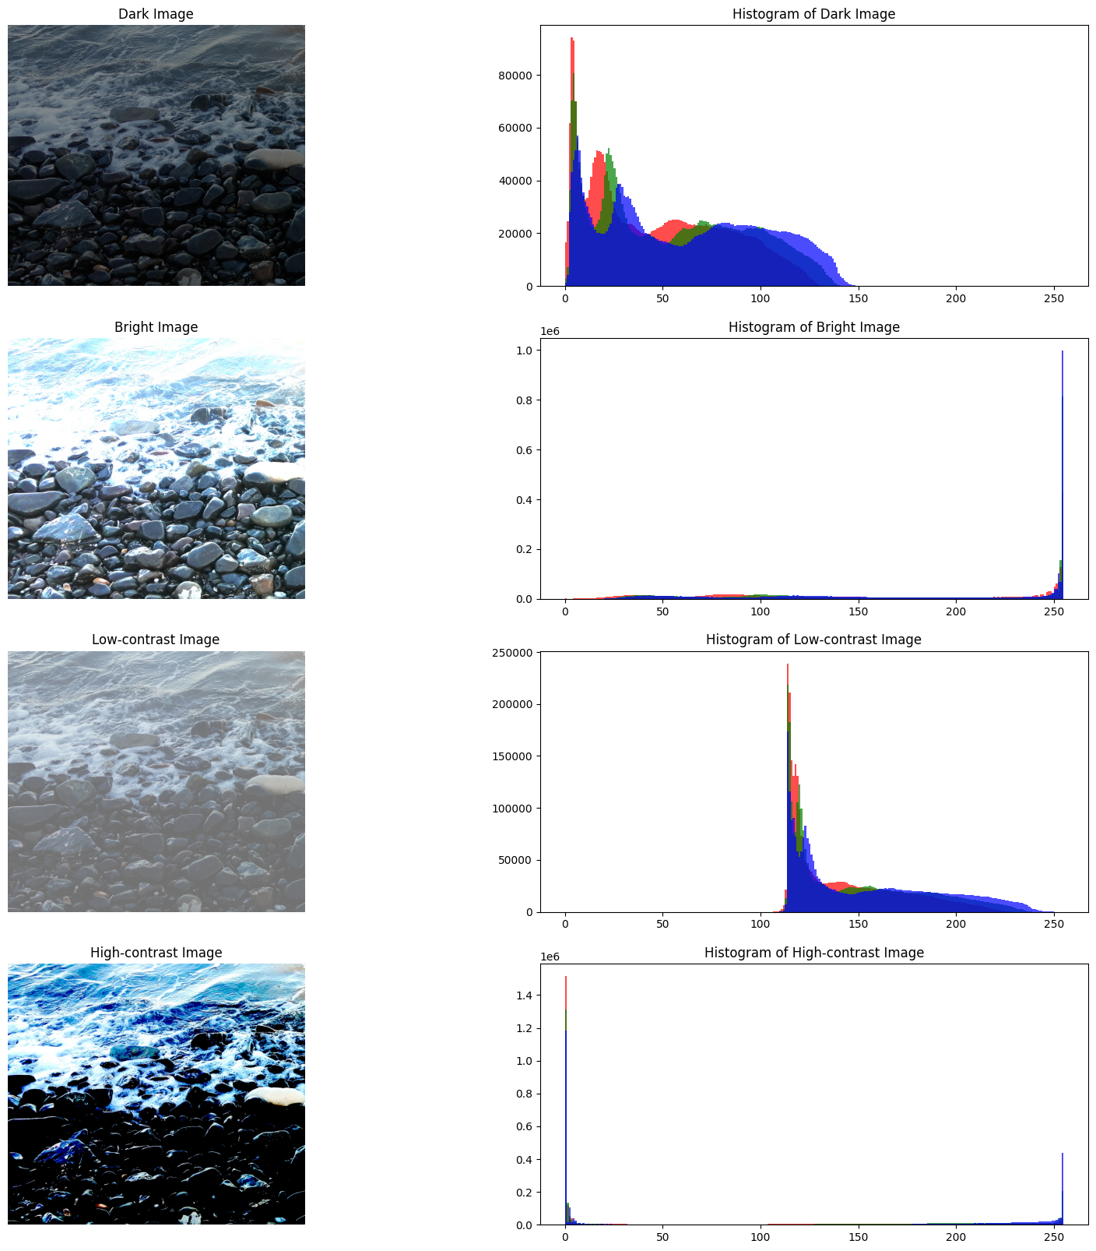

Slide 27
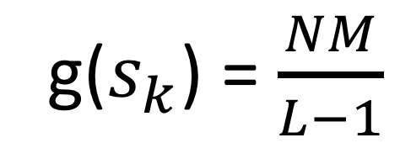
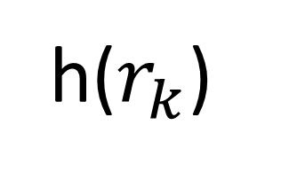
3.1. Histogram Equalization: Find a transformation, T, which yields a histogram with uniform density
h($r_{k}$)
g($s_{k}$) = $\frac{NM}{L−1}$
Histogram of the original image
Histogram of the equalized image

Slide 28
3.1. Histogram Equalization

Slide 29

Definition: Cumulative Histogram
A monotonically increasing function:
$h_{c}$($r_{k}$) = $\sum_{{j=0}_{}}^{k_{}}{ h}$($r_{j}$)

Slide 30

Example:Find the histograms and cumulative histograms of the following 2 bits/pixel images:
$f\left(x,y\right)= \begin{matrix}0 & 0 & 0 0 \\ 0 & 0 & 1 2 \\ 0 & 1 & 1 2\end{matrix} and g\left(x,y\right)=\begin{matrix}0 & 1 & 2 3 \\ 0 & 1 & 2 3 \\ 0 & 1 & 2 3\end{matrix}$

Slide 31
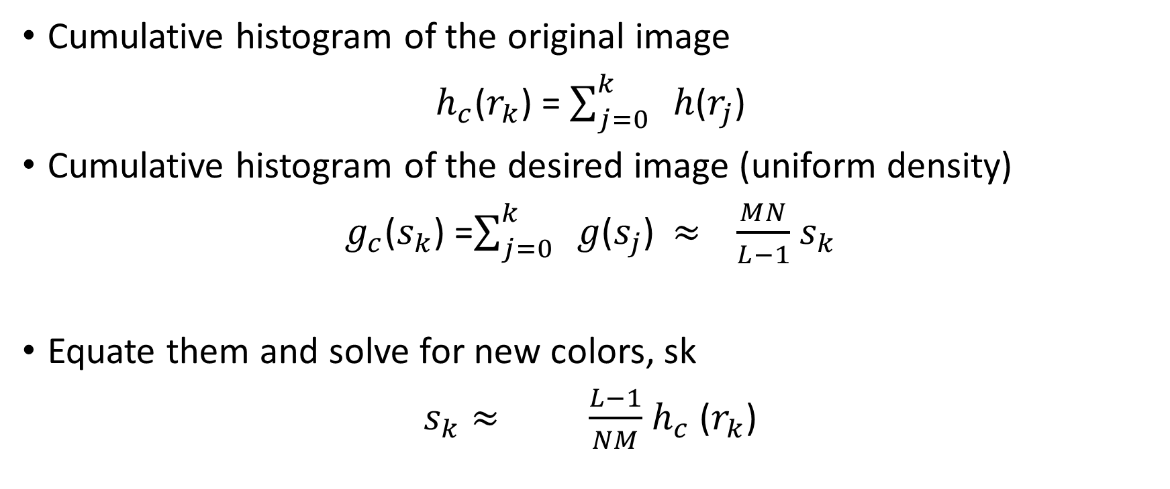
Define cumulative histograms and equate them
Cumulative histogram of the original image
$h_{c}$($r_{k}$) = $\sum_{j=0}^{k_{}}{ h}$($r_{j}$)
Cumulative histogram of the desired image (uniform density)
$g_{c}$($s_{k}$) =$\sum_{j=0}^{k_{}}{ g}$($s_{j}$) $≈$ $\frac{MN}{L−1}$ $s_{k}$
Equate them and solve for new colors, sk
$s_{k}≈$ $\frac{L−1}{NM}$ $h_{c}$ ($r_{k}$)

Slide 32

Algorithm: Histogram Equalization
Find the histogram $h(rk)$
Find cumulative histogram, $hc(rk)$
Set $sk= T(rk) = round[\frac{L−1}{NM}].hc(rk)$
Create equalized image with the new color palatte, s_{k}= T(r_{k})

Slide 33

Example: Find the equalized histogram and the corresponding image of the following 3 bits/pixel image:
f(x,y) = $\begin{matrix}1 & 1 & 1 1 \\ 1 & 1 & 2 3 \\ \begin{aligned}1 \\ 1\end{aligned} & \begin{aligned}2 \\ 3\end{aligned} & \begin{aligned}3 3 \\ 3 4\end{aligned}\end{matrix}$

Slide 34

Example: Find the equalized histogram and the corresponding image of the following 3 bits/pixel image:
f(x,y) = $\begin{matrix}1 & 1 & 1 1 \\ 1 & 1 & 2 3 \\ \begin{aligned}1 \\ 1\end{aligned} & \begin{aligned}2 \\ 3\end{aligned} & \begin{aligned}3 3 \\ 3 4\end{aligned}\end{matrix}$ g(x,y) = $\begin{matrix}4 & 4 & 4 4 \\ 4 & 4 & 5 7 \\ \begin{aligned}4 \\ 4\end{aligned} & \begin{aligned}5 \\ 7\end{aligned} & \begin{aligned}7 7 \\ 7 7\end{aligned}\end{matrix}$
Original Image Equalized Image

Slide 35
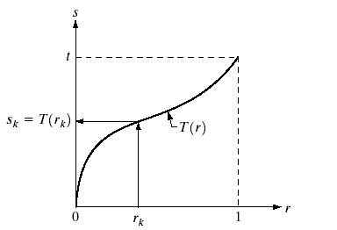
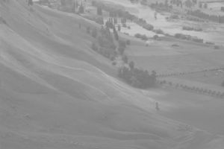
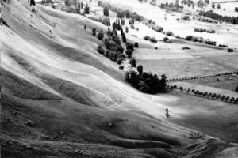
Histogram Equalization
Find a transformation which yields a histogram with uniform density
T ?
Histogram
Equalization

Slide 36
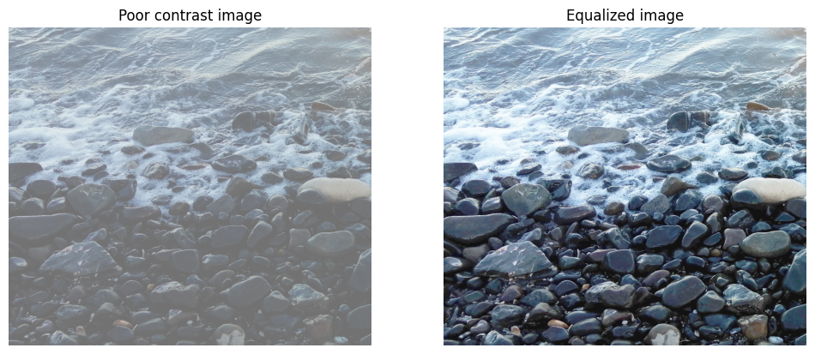

Slide 37
Question
Is histogram equalization always good?
No

Slide 38
Applying histogram equalization does not always provide the desired image
While stretching the contrast, we may lose some important colors
We cannot remove the undesired colors.
Histogram equalization spoils the high contrast images.

Slide 39
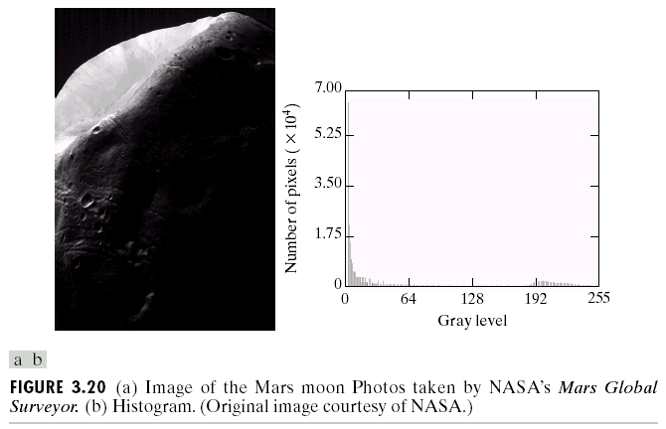
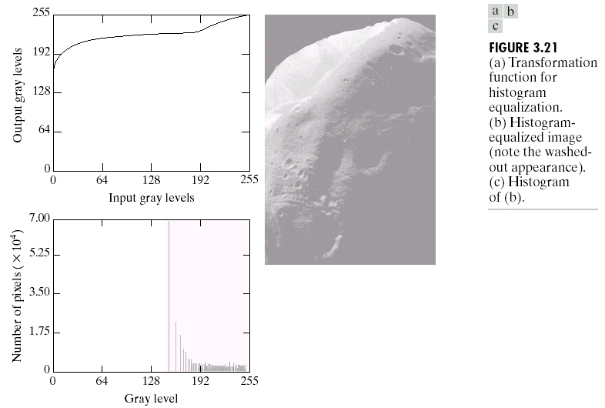
Histogram of a dark image and its equalization

Slide 40
Histogram specification: Match the histogram to a desired histogram

Slide 41
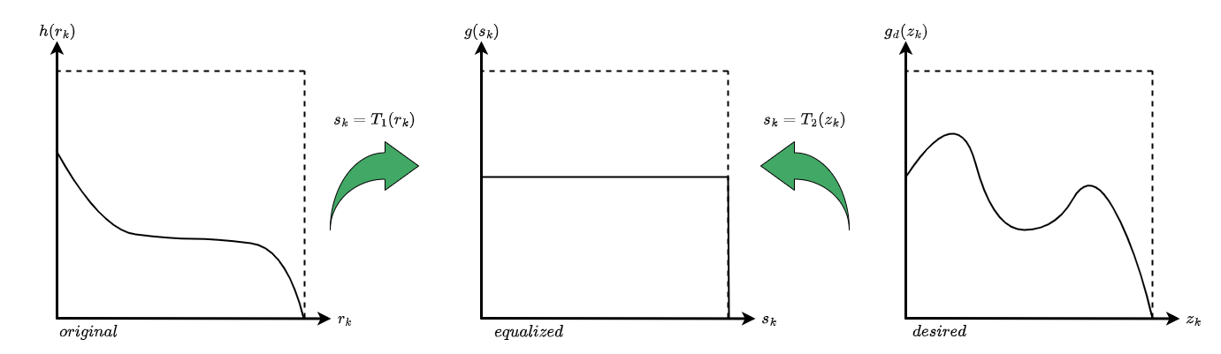
Equalize both the original and desired histograms

Slide 42
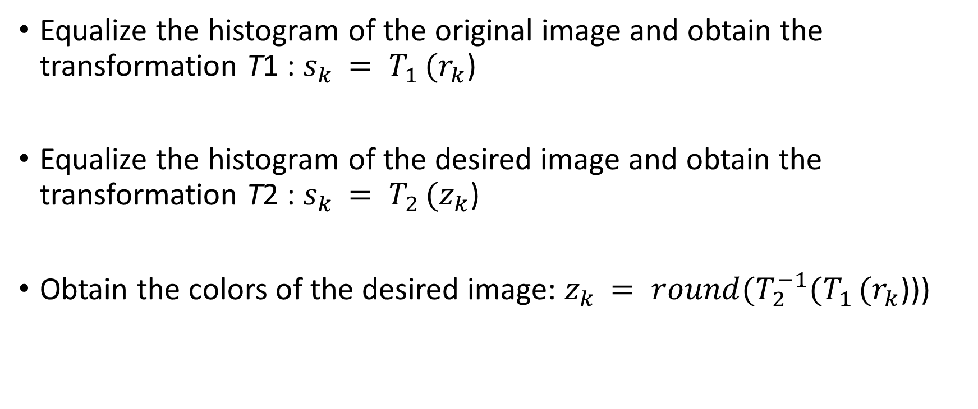
Algorithm: Histogram Specification
Equalize the histogram of the original image and obtain the transformation T1​ : $s_{k }= T_{1 }(r_{k}$)
Equalize the histogram of the desired image and obtain the transformation T2​ : $s_{k }= T_{2 }(z_{k}$)
Obtain the colors of the desired image: $z_{k }= {round(T_{2}^{−1}(T}_{1 }(r_{k}$)))

Slide 43
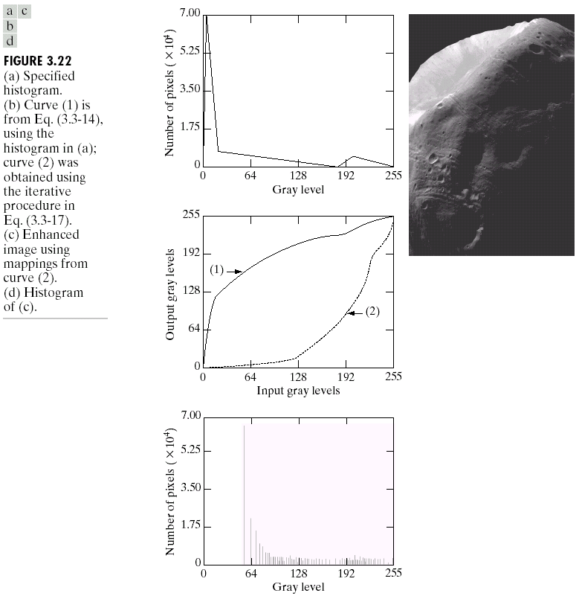
Dark image and specified image

Slide 44
Local Histogram Processing
Define a neighborhood and move its center from pixel to pixel
At each location, the histogram of the points in the neighborhood is computed. Either histogram equalization or histogram specification transformation function is obtained
Map the intensity of the pixel centered in the neighborhood
Move to the next location and repeat the procedure

Slide 45
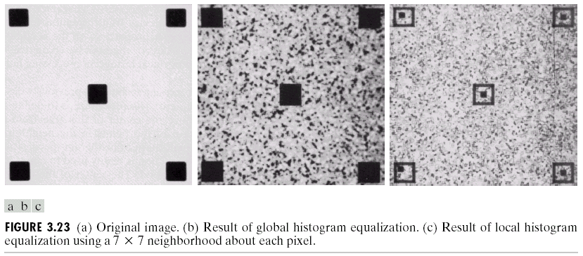
Local vs. Global Histogram Equalization

Slide 46
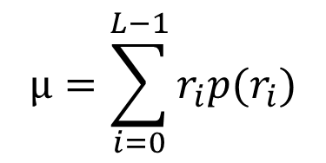
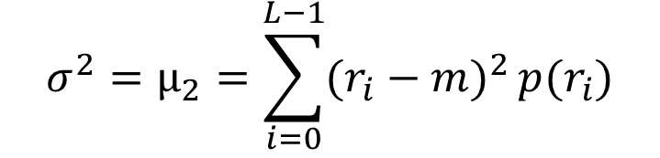
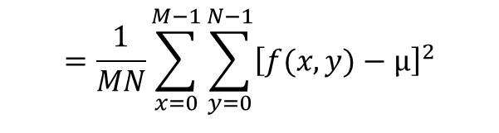
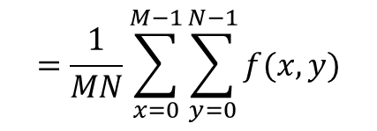
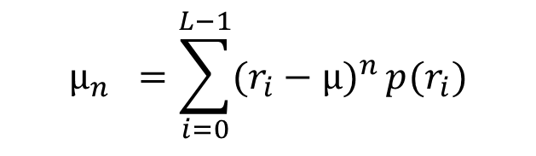
Using Histogram Statistics for Image Enhancement
Average Intensity
$$µ=\sum_{i=0}^{L−1}{r_{i}p(r_{i})}$$
$$=\frac{1}{MN}\sum_{x=0}^{M−1}{\sum_{y=0}^{N−1}{f(x,y)}}$$
$$µ_{n} =\sum_{i=0}^{L−1}{(r_{i}−µ)^{n}}p(r_{i})$$
Variance
$$σ^{2}=µ_{2}=\sum_{i=0}^{L−1}{(r_{i}−m)^{2}}p(r_{i})$$
$$=\frac{1}{MN}\sum_{x=0}^{M−1}{\sum_{y=0}^{N−1}{{\left[f(x,y)−µ\right]}^{2}}}$$

Slide 47
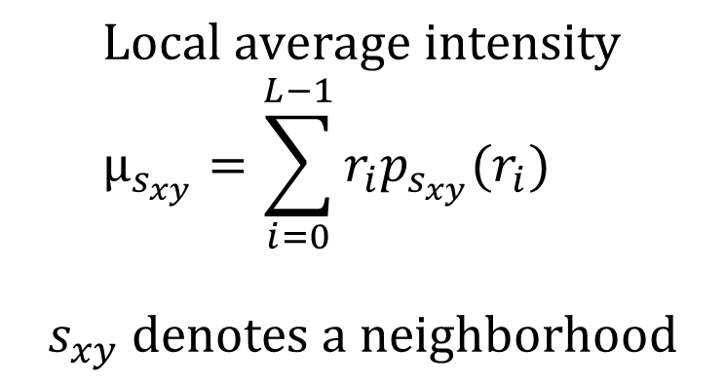
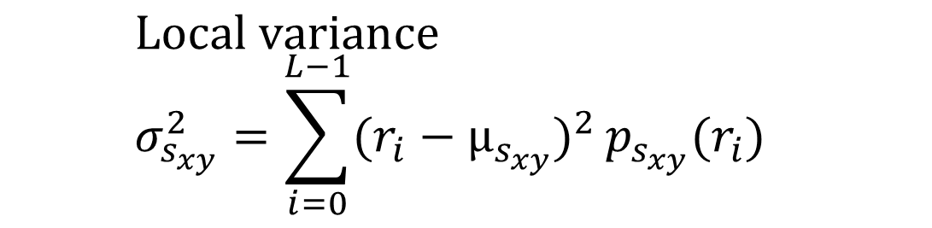
Using Histogram Statistics for Image Enhancement
$$\text{Local} \text{average} \text{intensity} \\ µ_{s_{xy}}=\sum_{i=0}^{L−1}{r_{i}p_{s_{xy}}(r_{i})}$$
$$s_{xy} \text{denotes} \text{a} \text{neighborhood}$$
$$\text{Local} \text{variance} \\ σ_{s_{xy}}^{2}=\sum_{i=0}^{L−1}{(r_{i}−µ_{s_{xy}})^{2}}p_{s_{xy}}(r_{i})$$

Slide 48
Using Histogram Statistics for Image Enhancement: Example

Slide 49
Using Histogram Statistics for Image Enhancement: Example

Slide 50

Quiz#2: Find the bit plane representation of the following image
f(x,y) = $\begin{matrix}0 & 0 & 1 2 \\ 0 & 1 & 2 3 \\ \begin{aligned}1 \\ 2\end{aligned} & \begin{aligned}2 \\ 3\end{aligned} & \begin{aligned}3 0 \\ 0 0\end{aligned}\end{matrix}$

